Slide 1

Guide for the OLA (Online Learning Agreement)

Slide 2
The Online Learning Agreement
The Online Learning Agreement is a study agreement that must be signed by the Student, the Home University and the Host University.
If your home university provides a dedicated study platform, feel free to utilize it for completing your Learning Agreement. Alternatively, you can use the European Dashboard website dedicated to Erasmus students.
This document contains all the academic activities you intend to carry out at the University of Parma. If required by your Home University, the L.A. can also include the activities that will be recognized by your Home University at the end of your study period.
Amendments to the Online Learning Agreement can only be made if you have already the Before the Mobility section signed by both Universities.

Slide 3
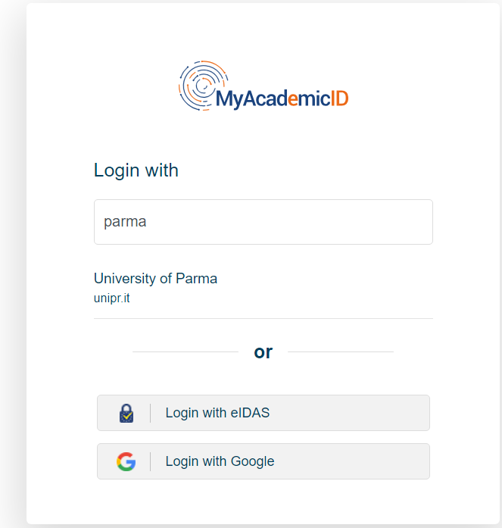
How to create an account:
Log in at the website with your Academic ID
Enter your university in the search bar and select the respective field, then log in with your credentials.

Slide 4
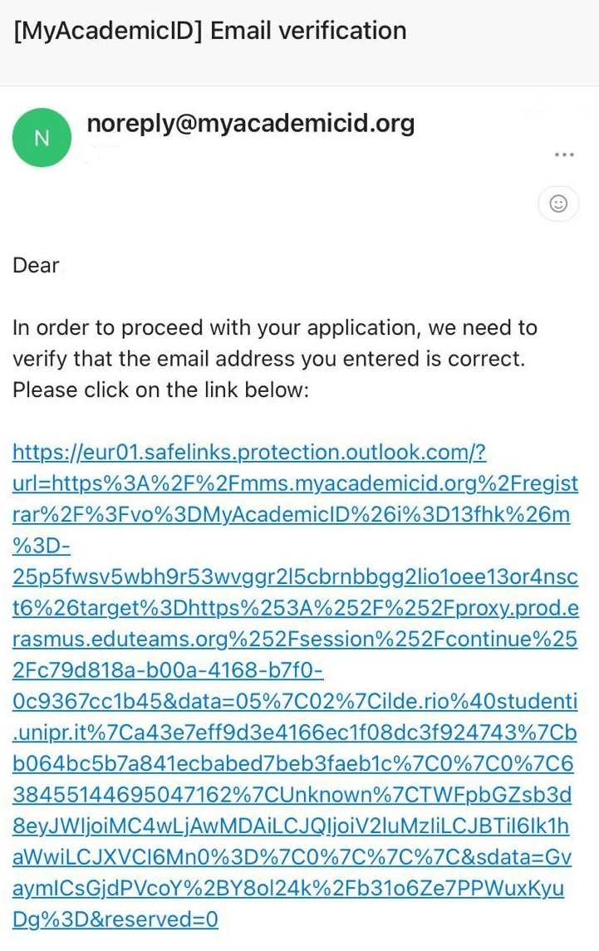

How to create an account:
After the first step, follow the indicated procedure
A 'My academic registration' page will open where you will need to enter your first name, last name, and university email and confirm the Policy
At this point you will receive an e-mail to verify you e-mail address

Slide 5
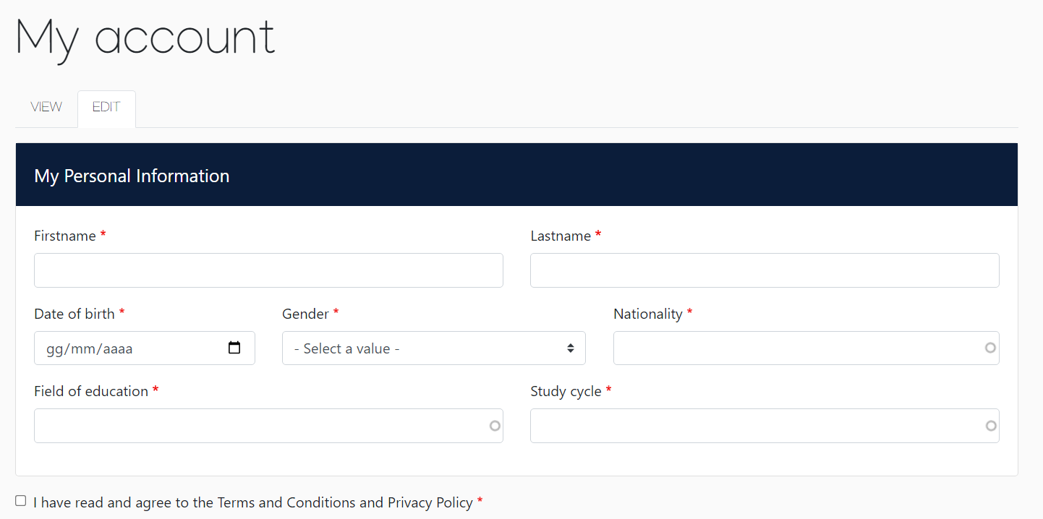
How to create your Learning Agreement:
Once the account is created, you have to create a new Learning Agreement
First you have to select your mobility type
Then you have to insert your personal informations to create your Account

Slide 6
Contact and responsible persons at Unipr:
Insert the informations about your Home Institution
Sending Responsible Person is an academic who has the authority to approve your Learning Agreement and to guarantee full recognition of such programme
Receiving Institution: University of Parma
While completing your Learning Agreement you are asked to indicate Contact person and Responsible person.
Contact person is the administrative person from the International office of the University of Parma while the Responsible person is the professor in charge to evaluate and approve your Learning Agreement:
CONTACT PERSON | Head of the International Division (Administration) | Dr. Alessandro Bernazzoli Head of International Division Phone: +39.0521.904203 E-mail: incoming@unipr.it
RESPONSIBLE PERSON | The professor that will approve your Learning Agreement (Academic Part) | Please identify your Department Coordinator from THIS LIST
Here you can find the website

Slide 7
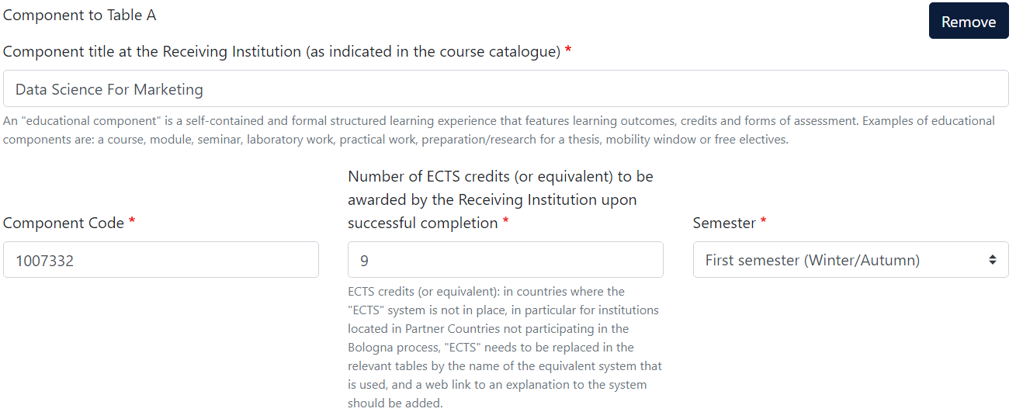
How to create your Learning Agreement:
Now you have to create a preliminary LA with both expected dates of start and end of mobility and insert the study program you are willing to follow in Parma

Slide 8
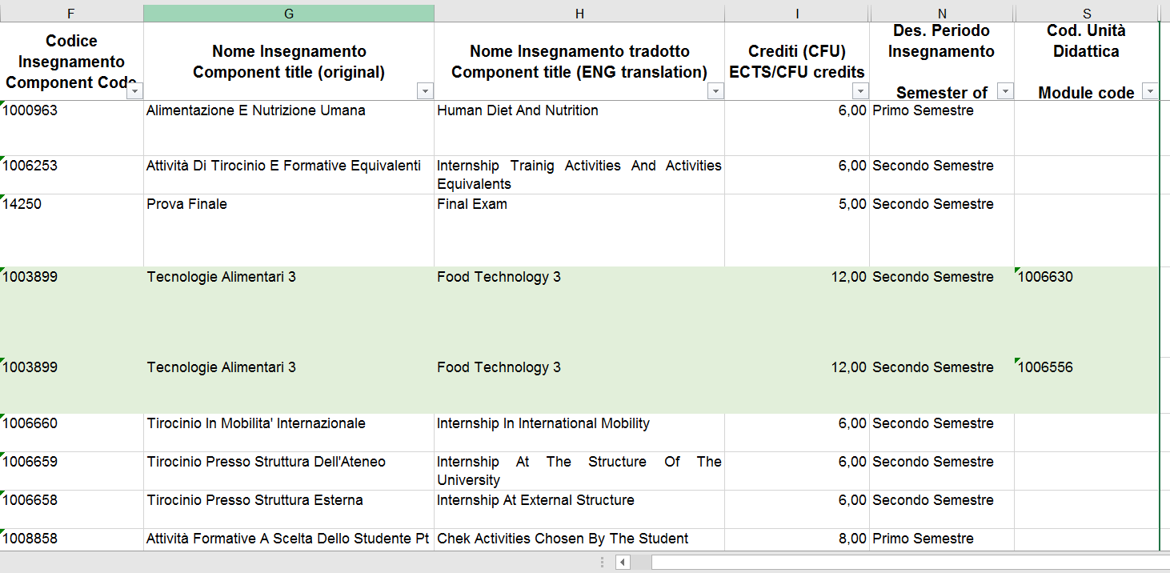
How to find the infos to fill in your study plan?
In this website you will find all the information you need to fill in your study plan (for Medicine Department students view also pages 11-12) .
In column F you will find the Component Code
If applicable:
In column S you will find the Code of the single Module
In column G you will find the Component title at the Receiving Institution
In column I you will find the amount of ECTS credits
In column N you will find the semester

Slide 9
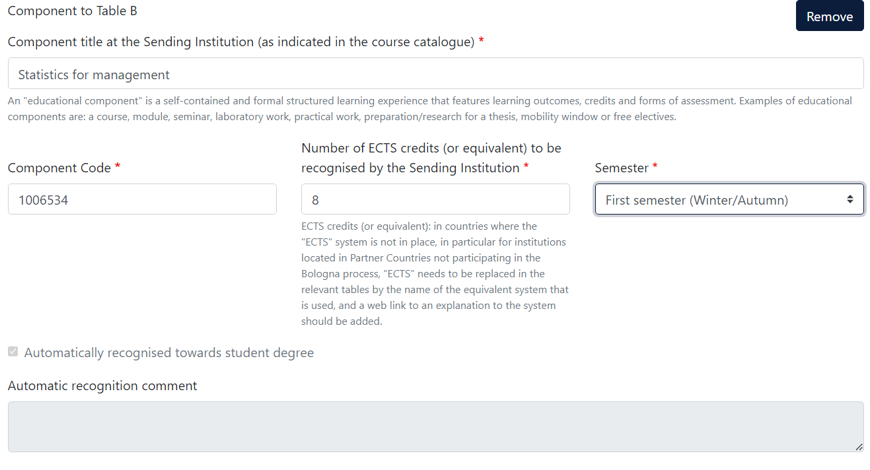
Table B:
You have to do the same with the study program of your Sending Institution, in this case you have to fill in the boxes with the data related to the corresponding course at your home university

Slide 10
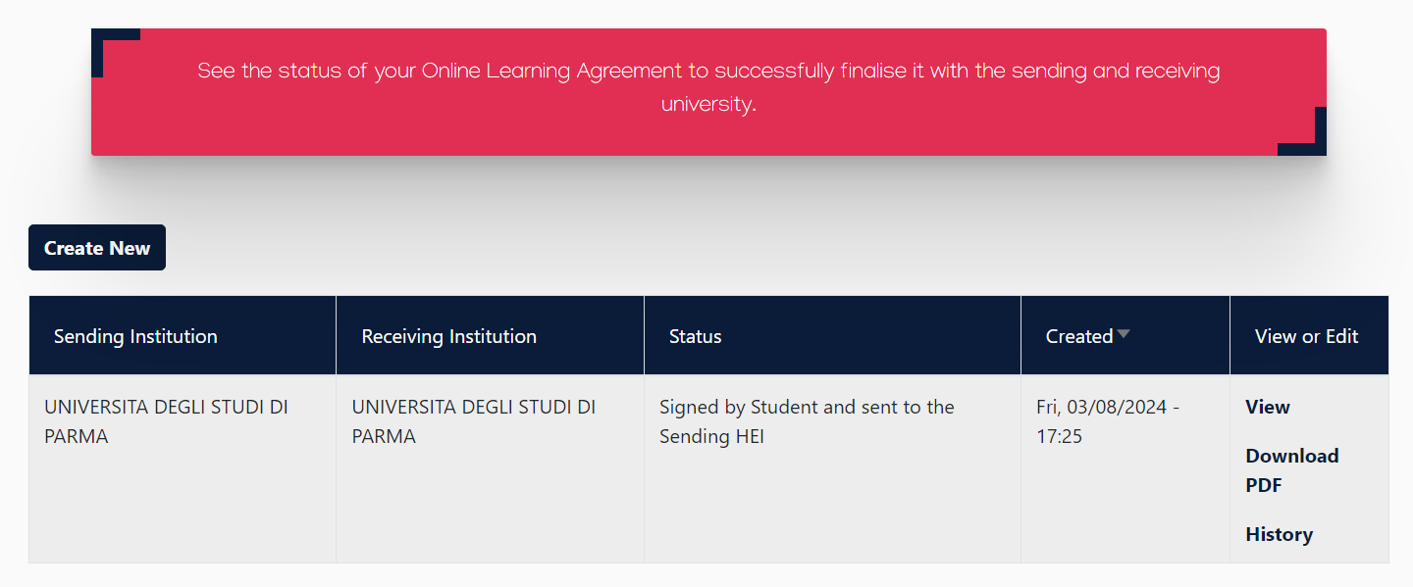
How to create your Learning Agreement:
It’s the time to sign and confirm the LA!
The system will now send the proposed LA to your Home Responsible Person for approvation (the E-mail will be sent from this address: no-reply@learning-agreement.eu).
Once it is signed, it will go to the Responsible Person in Parma.
When it finalized you have to download the PDF and send via E-mail to incoming@unipr.it
UNIVERSITY OF PARIS

Slide 11
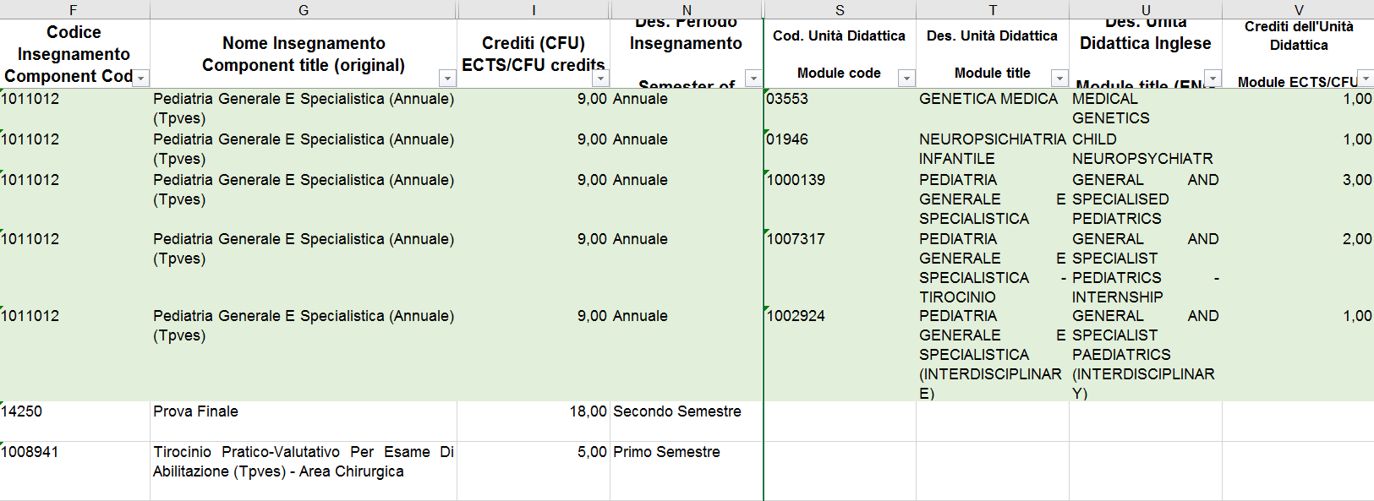
For Medicine Department students:
In this website you will find all the information you need to fill in your study plan.
In column F you will find the Component Code
In column G you will find the Component title at the Receiving Institution
In column N you will find the semester
In column S you will find the code of the module
In column T you will find the title of the module
In column V you will find the amount of CFU/ECTS for the Module
The cells highlighted in green refer to exams that have modules, hence you see the Component Title repeated for each Module. The credits indicated are for the whole subject.

Slide 12
For Medicine Department students:
You will find the Component Code in column F and it refers to the Exam
Indicate the Component Title of the Exam (column G), then if you are not going to take all the modules, you have to specify each module Code (Column S) and Module title (column T) for all the modules you going to take
Here you have to write the total amount of ECTS (column V).
If you are going to take few modules instead of the full exams, you have to indicate the total amount of ects/cfu.

Slide 13
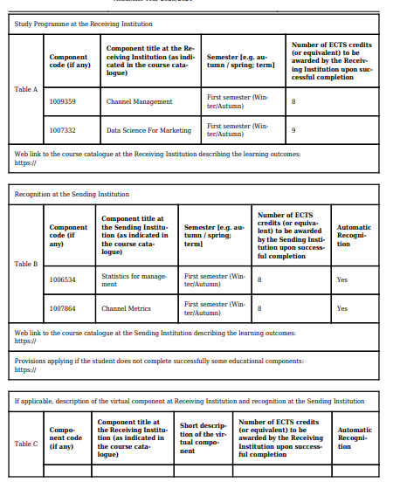
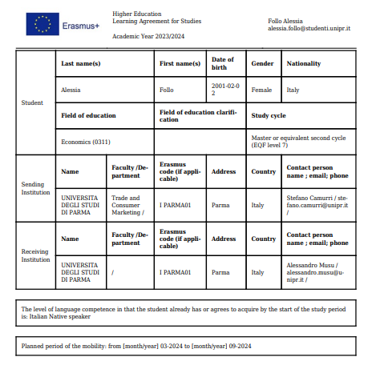
An example:

Slide 14
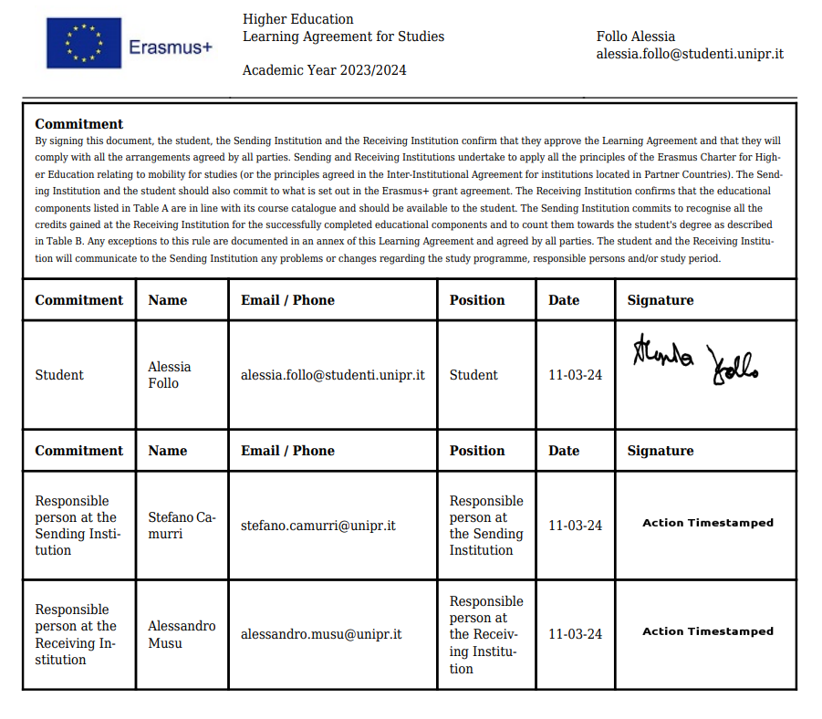
An example:

Slide 15
To summarise:
The OLA (and its changes) must contain all signatures (Student, Home University and Host University)
Make sure a copy of the OLA (and its changes) is filed at the Erasmus and International Home. In case of doubt send again to incoming@unipr.it
DEADLINE: the During the Mobility section must be submitted within one month from the beginning of the courses (31° October for the first semester and 31° March for the second semester)
Only one amendment to the OLA is allowed per semester
Add the course of Italian and/or Teaching Placement in the OLA (Before the Mobility or During the Mobility section) if you want the recognition of credits.

Slide 16
www.unipr.it Stefano Camurri

